Slide 1
Monitoring & Optimization

Slide 2
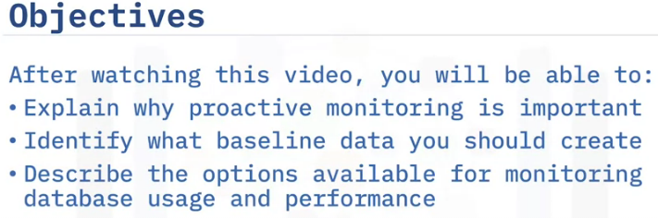
Overview of Database Monitoring

Slide 3
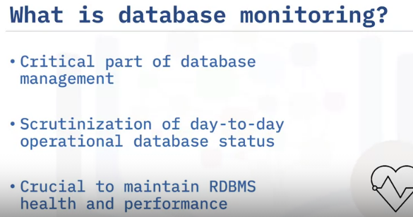
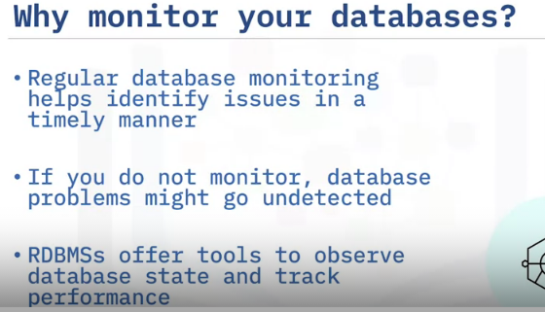
For many database admins, one of the most challenging and necessary elements of database management is performance tuning, and one of the critical parts of this process is database monitoring.
The term database monitoring refers to the different tasks related to the
scrutinization of the day-to-day operational status of your database.
Database monitoring is crucial to maintain the health and performance of your relational database management system, regardless of which vendor’s database product you are using.
When you perform regular database monitoring it helps to identify issues in a timely manner so that you can maintain the health and accessibility of your database system.
If you do not perform this monitoring function, then problems and outages in your database might go undetected until it is too late.
This can cause your users and customers to lose confidence in your service and potentially your organization could lose customers and income because of it.
Most relational database management systems offer tools that enable you to observe the current state of your databases and to track their performance as circumstances vary over time.

Slide 4
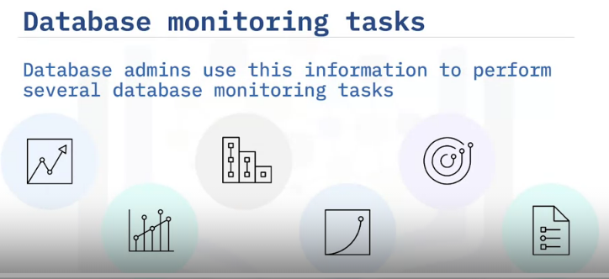
As a database admin, you can then utilize this useful information to perform several database monitoring tasks, including:
Forecasting your future hardware requirements based on database usage patterns.
Analyzing the performance of individual applications or database queries.
Tracking the usage of indexes and tables.
Determining the root cause of any system performance degradation.
Optimizing database elements to provide the best possible performance.
Assessing the impact of any optimization activities.

Slide 5
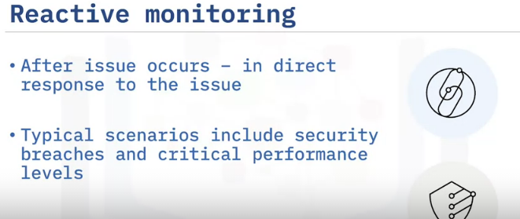
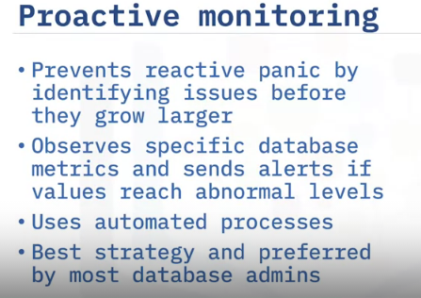
Reactive monitoring is done after an issue occurs, when you act in direct response to that issue; perhaps by fixing a configuration setting or adding more resources, for example.
The most common situations when reactive monitoring occurs is either when your database security has been breached, or the performance of your database reaches critically low levels, or when some other kind of major database incident occurs that greatly impacts your business and therefore needs resolving as soon as possible.
In contrast, a proactive monitoring strategy seeks to prevent this reactive panic by identifying issues before they grow into large problems.
This is primarily achieved by observing specific metrics from your database and then sending alerts to interested parties if the values of these metrics reach abnormal levels.
Proactive monitoring typically utilizes automated processes to perform tasks such as regularly verifying that a database system is online and accessible, verifying that configuration changes do not adversely affect the performance of the database system, and that the database system is operating and performing at acceptable levels.
This proactive approach is widely considered to be the better strategy and is preferred by most database admins.

Slide 6
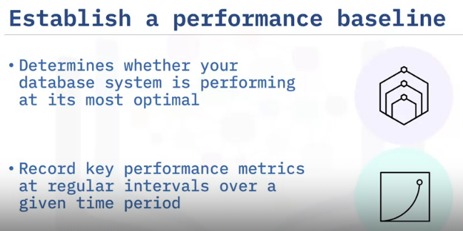
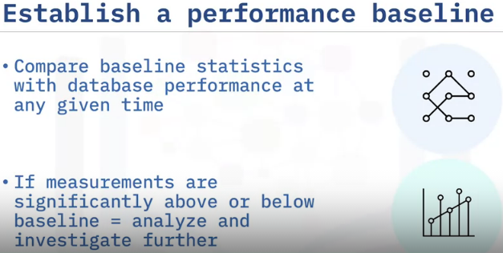
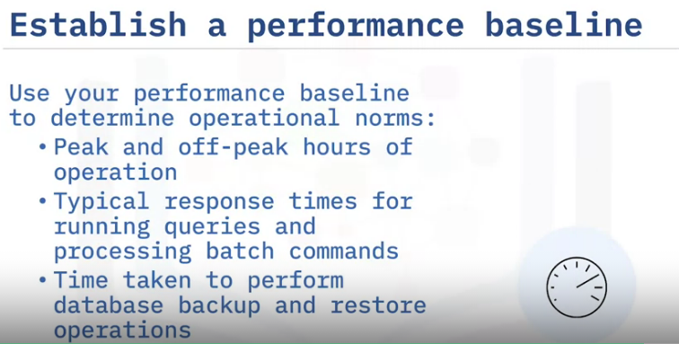
To determine whether your database system is performing at its most optimal, you first need to establish a baseline for your database system’s performance.
To do this, you need to record key performance metrics at regular intervals over a given time period.
Once you have established a database system performance baseline, you can then compare these baseline statistics with the performance of your database system at any given time.
If your comparison indicates that the current performance measurements are either significantly above or below the performance baseline, then these can become potential targets for further analysis and investigation.
From those investigations, you might then determine that some database elements need reconfiguring or optimizing.

Slide 7
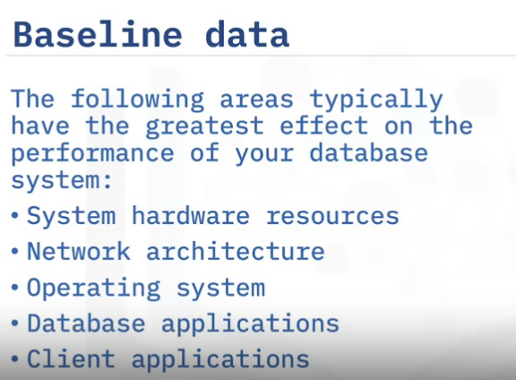
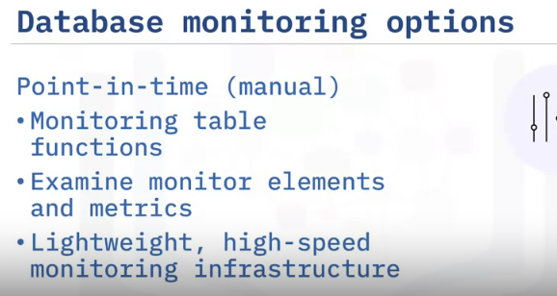
There are two ways to monitor operations in your database.
You can view information that shows the state of various elements of your database in real time using monitoring table functions.
For example, you can use a monitoring table function to examine the total amount of space used in a table.
These table functions let you examine monitor elements and metrics that report on virtually all aspects of database operations.
The monitoring table functions use a lightweight, high-speed monitoring infrastructure

Slide 8
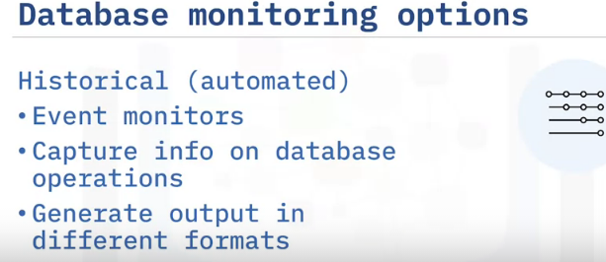
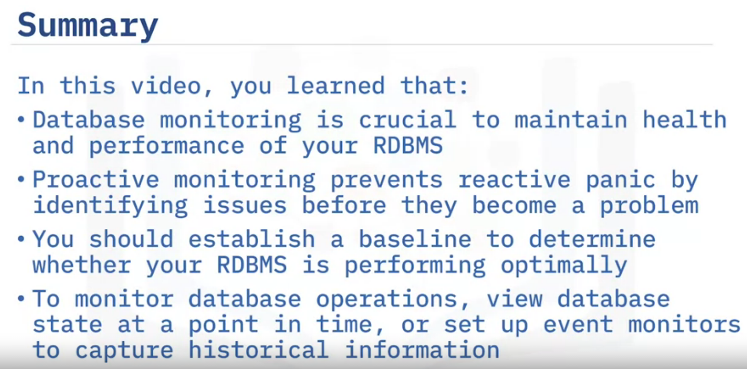
Alternatively, you can set up event monitors to capture historical information as specific types of database events occur over a given time period.
Event monitors capture information about database operations over time, as specific types of events occur.
For example, you can create an event monitor to capture information about locks and deadlocks as they occur in the system.
Or you might create an event monitor to record when a threshold that you specify (for example, the total processor time used by an application or workload) is exceeded.
Event monitors generate output in different formats and can write this output to regular tables.

Slide 9
Moonitoring Usage & Performance – Part 1
Objective:
Why you need to monitor at different levels
4 levels at which you should monitor

Slide 10
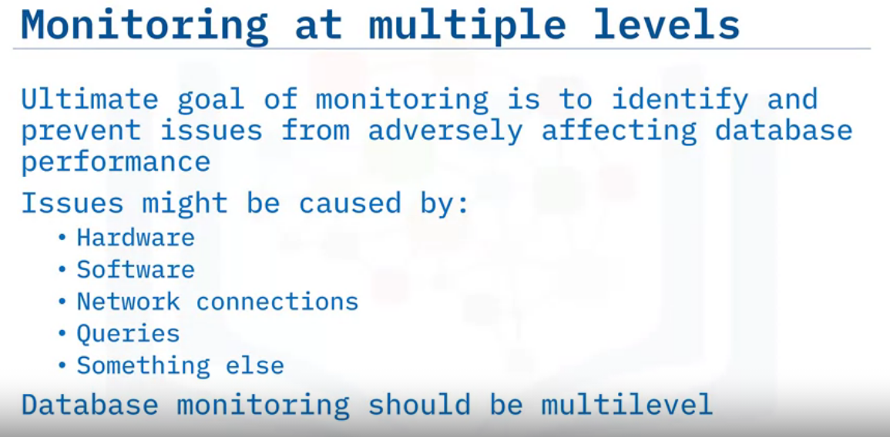
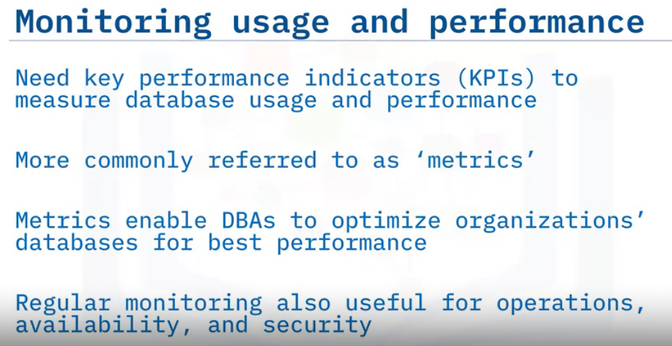
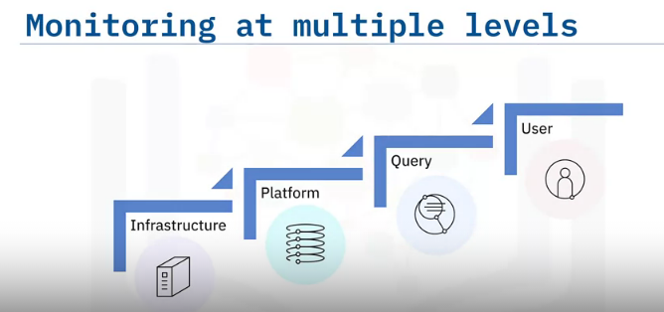
4 Monitoring levels

Slide 11
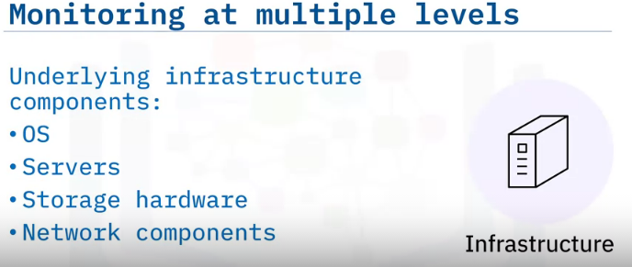
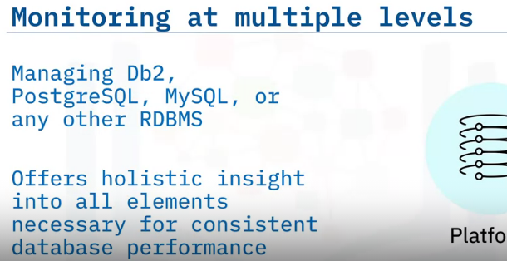
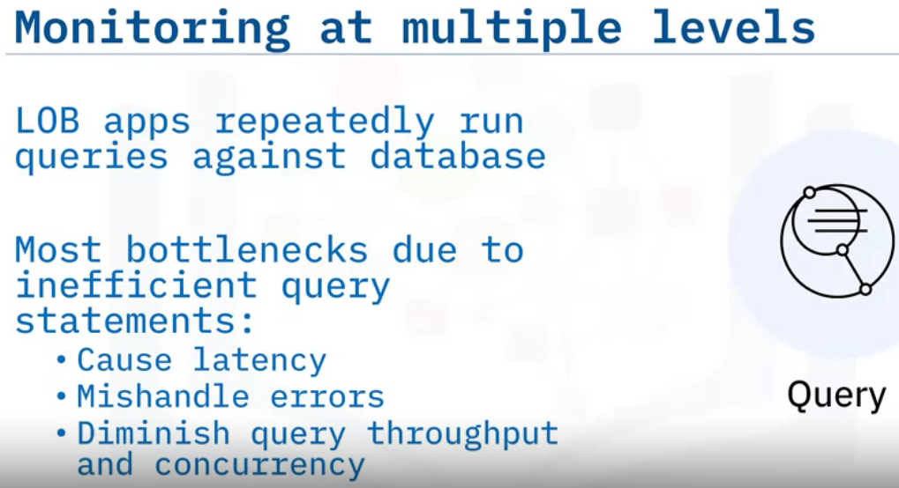
Platform/instance level
It’s vital that all the underlying infrastructure components, such as operating systems, servers, storage hardware resources, and network components be working efficiently under the hood of the database platform and the queries.
Irrespective of whether you’re handling relational database systems such as Db2, PostgreSQL, MySQL, or any other flavor of relational database system for that matter, or if you’re managing a combination of more than one of them together, each platform is a consideration in terms of performance.
Database monitoring at the platform level is crucial because it offers holistic insight into all the elements necessary to maintain consistent database performance.
Typically your line-of-business applications will be repeatedly running queries against your database instances, and then formatting and returning the relevant results of those queries to your users.
The majority of bottlenecks that might occur at this level will primarily be due to inefficient query statements that may cause latency, mishandle errors and diminish query throughput and concurrency.

Slide 12
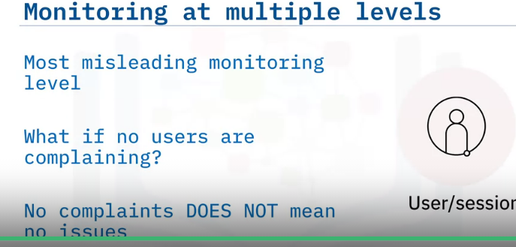
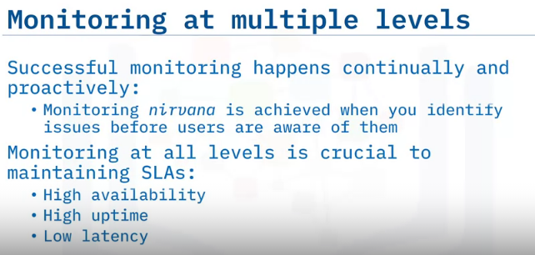
This level can often be the most misleading monitoring level of them all, because if your users are complaining about something not working, then you can just obtain further information about the issue they are having, investigate it, and hopefully fix it.
But what if your users aren’t currently complaining about things not working?
Can you just assume that everything is running fine, put your feet up, and relax? Unfortunately, no. Just because there may not be an issue right now, doesn’t mean that there won’t be one just around the corner.
Truly successful monitoring means constantly monitoring the usage, performance, and behavior of your database system in a proactive and continuous manner.
The ‘nirvana’ of database monitoring is achieved when you proactively identify issues before your users are even aware of them.
Monitoring at all four of these levels is crucial to maintaining service level agreements (or SLAs), such as high availability, high uptime, and low latency for your databases

Slide 13
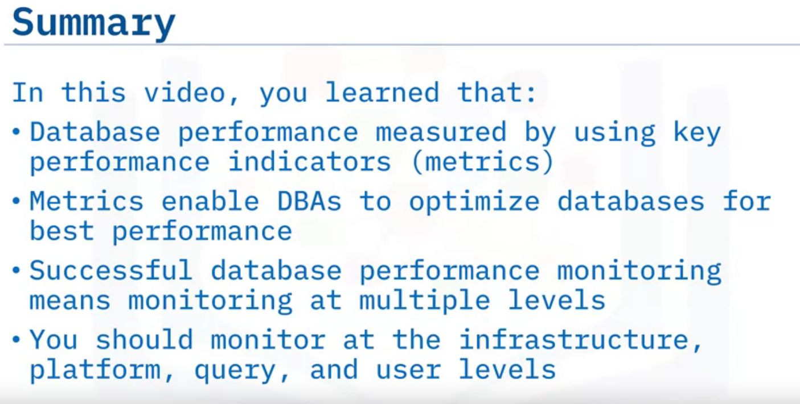

Slide 14
Monitoring Usage & Performance- Part 2
Describe key database Usage & Performance metrics
Describe in-product tools for reviewing metrics
Describe third party monitoring tools

Slide 15
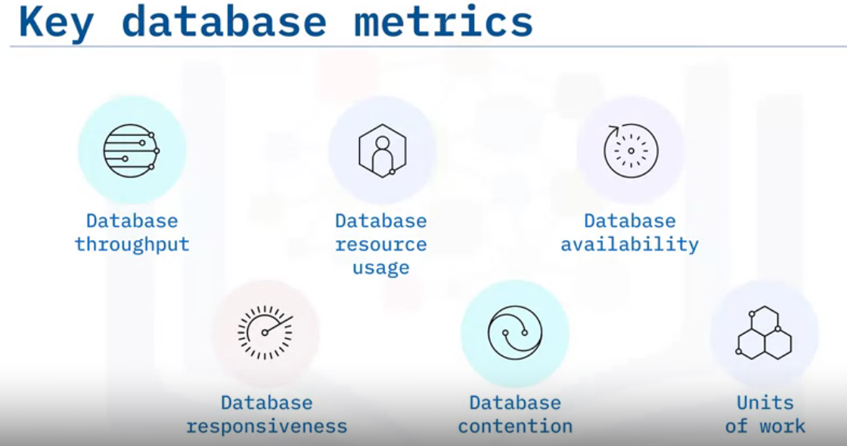
Database throughput is one of the most significant metrics of database performance. It indicates how much total work is being taken on by your database and is typically measured by the number of queries executed per second.
Database resource usage monitors the database resource usage by measuring the CPU, memory, log space, and storage usage. This summary metric represents the database resource usage by two aspects: average/max/latest number and time series number.
Database availability signals whether the database is up or down, that is, available or unavailable. It is typically a summary metric that represents the historical data on available time as a percentage.
Database responsiveness shows how well the system is responding to inbound requests and is another of the more commonly used database performance metrics. It provides DBAs with information on the average response time per query for their database servers, indicating how quickly they respond with query results.
Database contention indicates whether there is any contention between connections, by measuring lock-waits and concurrent database connections. Database contention is the term used to describe what happens when multiple processes are competing to access the same database resource at the same time.
Units of work tracks what transactions (units of work) are consuming the most resources on the database server.

Slide 16
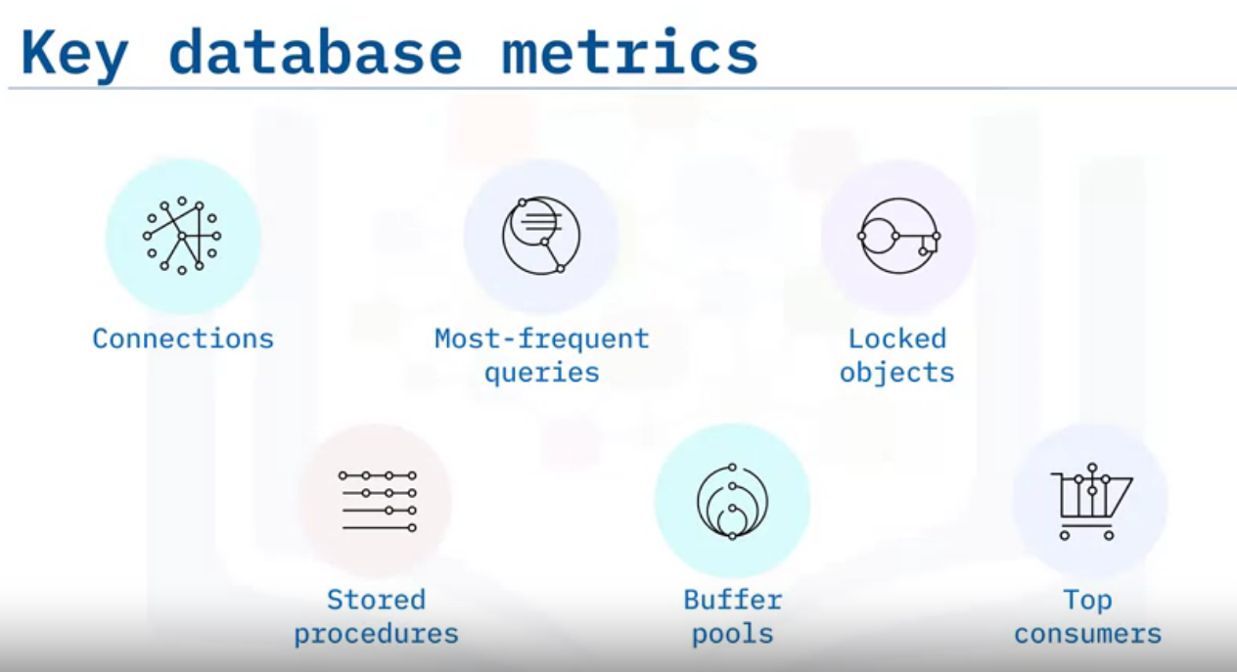
Here are some more key metrics:
Connections can display all kinds of network connection information to a database management console and can indicate whether a database server might fail due to long-running queries or having too many open connections.
Database connections are network connections that enable communication between clients and database software. Open connections are used for sending commands and receiving responses in the form of result sets.
Most frequent queries tracks the most frequent queries received by your database servers, including their frequency and average latency, that is, how long they take to be processed. It can help DBAs optimize these queries to gain substantial performance improvements.
Locked objects shows detailed information about any locked processes and the process that blocked them. Locks and blocks stop several concurrent transactions from accessing an object at the same time.
They put contending processes on hold until that object has been released and is accessible again.
Stored procedures displays the aggregated execution metrics for procedures, external procedures, compiled functions, external functions, compiled triggers, and anonymous blocks invoked since database activation.
Buffer pools tracks the usage of buffer pools and table spaces. A directory server uses buffer pools to store cached data and to improve database performance. When the buffer pool fills up, it removes older and less-used data to make room for newer data.
Top consumers shows the top consumers of a system’s resources and can help DBAs with capacity planning and resource placement.
Please note, this is just a small selection of the numerous metrics available in most database management systems.

Slide 17
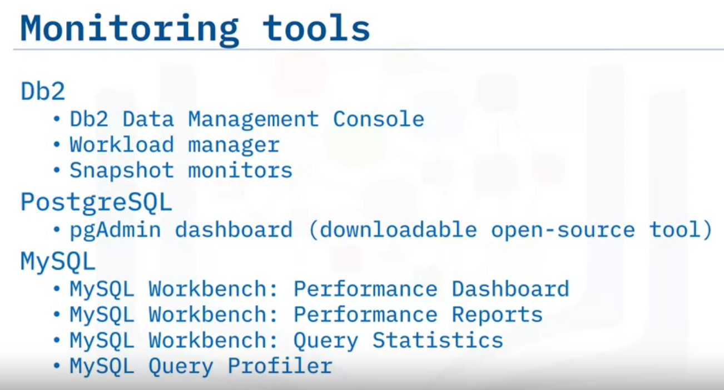
To review these key database performance metrics, you will use different out-of-the-box tools, depending on your database.
\

Slide 18
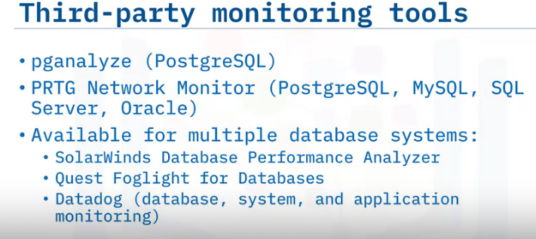
There are several third-party performance and query monitoring tools available to help you to monitor queries, optimize performance, and speed up your database. Some of them may also provide performance tuning and query optimization capabilities as well.
For PostgreSQL systems, there is the pganalyze tool which provides automatic insights into query plans, query analysis, database visualization and dashboards, log insights, and performance optimization and monitoring.
And if you have a PostgreSQL, MySQL, SQL Server or Oracle database and need a query-monitoring tool, you could try PRTG Network Monitor.
Many of the third-party tools are available for multiple database systems, such as SQL Server, Oracle, Sybase, Db2, MySQL, and PostgreSQL to name but a few.
SolarWinds offers a subscription-based monitoring solution called Database Performance Analyzer.
Foglight for Databases from Quest enables you to proactively monitor your complete database environment and view the state of all database platforms in a single comprehensive interface.
And Datadog is a SaaS platform that includes multiple system monitoring tools. It has more than 450 built-in integrations to connect to multiple different database systems.

Slide 19
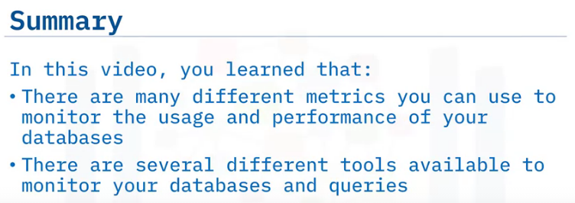

Slide 20
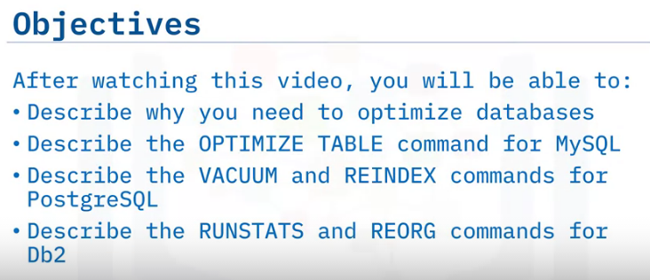
Optimizing Database

Slide 21
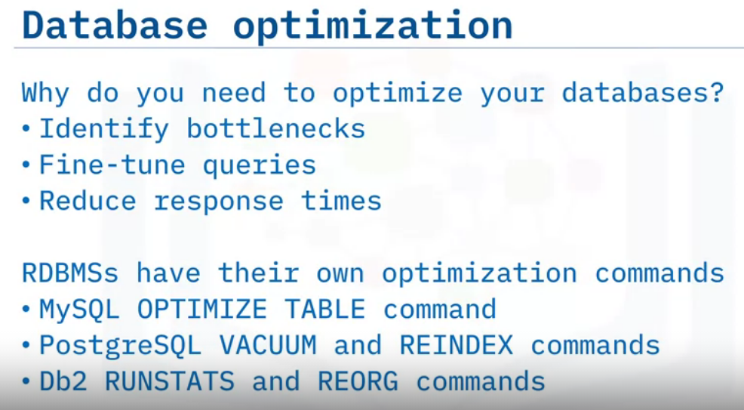
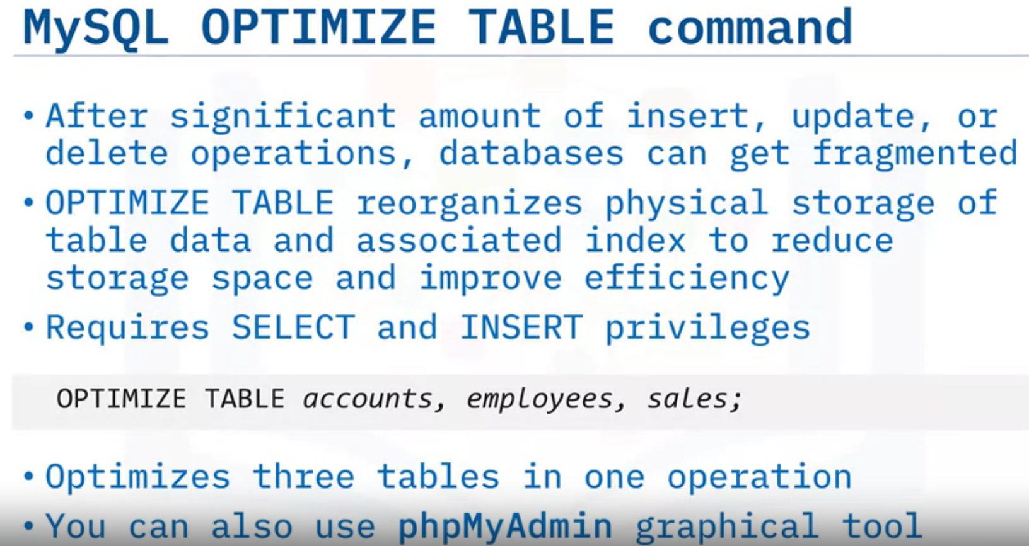
why do you need to optimize your databases? Well, over time as the volume of data stored in your databases increases, and their operational workloads increase, data can become fragmented, tables can be left empty or partially empty, and database performance can suffer.
By optimizing your databases, you can identify bottlenecks, fine-tune database queries, and ultimately reduce database response times for your users.
Each relational database system has its own utilities or commands for optimizing its databases. For example, for MySQL databases you can use the OPTIMIZE TABLE command.
For PostgreSQL databases you can use the VACUUM and REINDEX commands. And in Db2 you can use the RUNSTATS and REORG commands
If your MySQL database receives a significant number of insert, update, or delete operations, it can lead to fragmentation of your data files, meaning that a lot of unused space is wasted, which in turn can impact the database’s performance.
Therefore, it is recommended that database admins defrag their MySQL tables on a regular basis.
In MySQL, the OPTIMIZE TABLE command reorganizes the physical storage of table data and associated index data, to reduce storage space and improve input/output efficiency when accessing a table.
To use the OPTIMIZE TABLE command, you need to have SELECT and INSERT privileges for the table you are working on.
This example would optimize three different tables in one operation.
You could also use a graphical tool such as phpMyAdmin to optimize tables in MySQL.

Slide 22
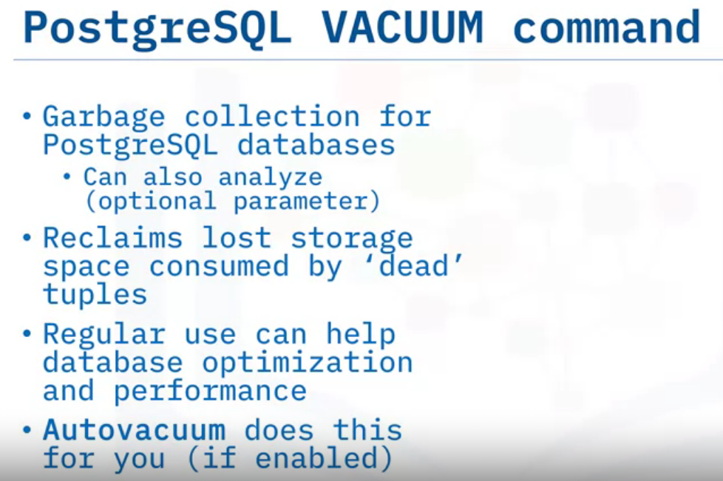
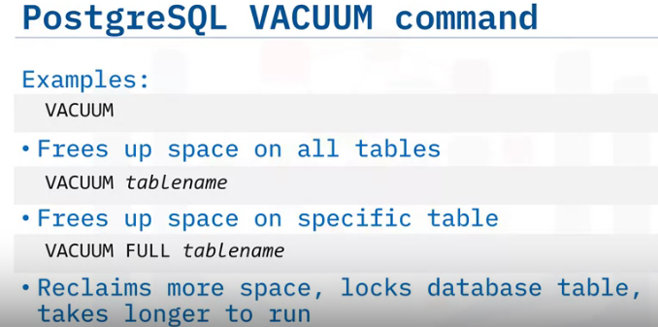
The VACUUM command can be used on your PostgreSQL databases to perform garbage collection, and optionally, analysis tasks.
VACUUM reclaims lost storage space consumed by ‘dead’ tuples, which are not physically removed from their database tables after being deleted or made obsolete by an update during routine PostgreSQL operations.
Regularly reclaiming this lost storage space can help improve your databases’ overall performance in PostgreSQL.
Please note that if the auto vacuum feature is enabled, then PostgreSQL will automate the vacuum maintenance process for you
In these examples, when you run VACUUM with no parameters the command will free up space on every table in every database that the current user has the rights to perform this command on.
If you specify the name of a table, then the command will only process and free up space on that table.
Without the FULL parameter, the VACUUM command can run alongside normal read and write table operations, as it does not require an exclusivity lock, and any reclaimed space is retained for future reuse within the table it was vacuumed from.
However, if you specify the FULL parameter, the command will create a complete copy of the table contents and write it to disk with no unused space, which allows the space to be reclaimed by the operating system.
So, using the FULL parameter can reclaim more space for you, but it takes much longer to run and requires an exclusivity lock on each table while it is being processed.

Slide 23
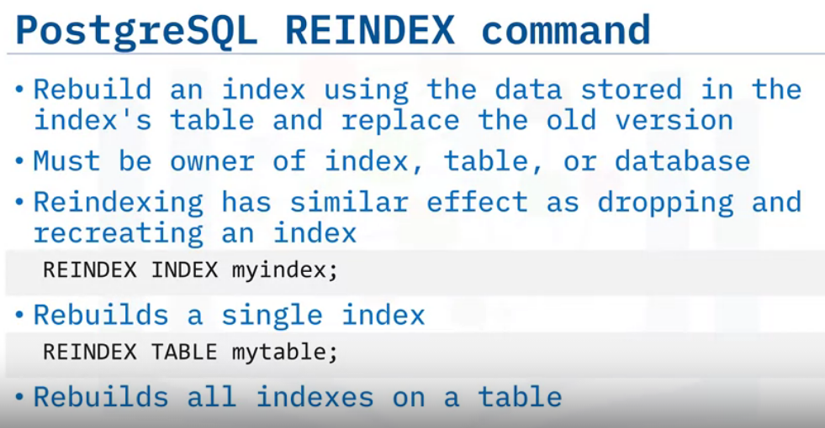
In PostgreSQL, you can use the REINDEX command to rebuild one or more indexes.
REINDEX rebuilds an index using the data stored in the index's table and replaces the previous, older, version of the index.
It can be used when software bugs or hardware failures have corrupted an index, or when an index has become bloated and contains numerous empty, or nearly empty, pages.
You need to be the owner of the index, or the table, or the database in order to reindex it.
When you use REINDEX, it rebuilds the index contents from scratch, and therefore it has a very similar effect as dropping and recreating an index.
However, the way that locks on reads and writes works on them is different.
Here are some REINDEX usage examples. The first example will rebuild the index named myindex.
The second example will rebuild all the indexes on the table named mytable.

Slide 24
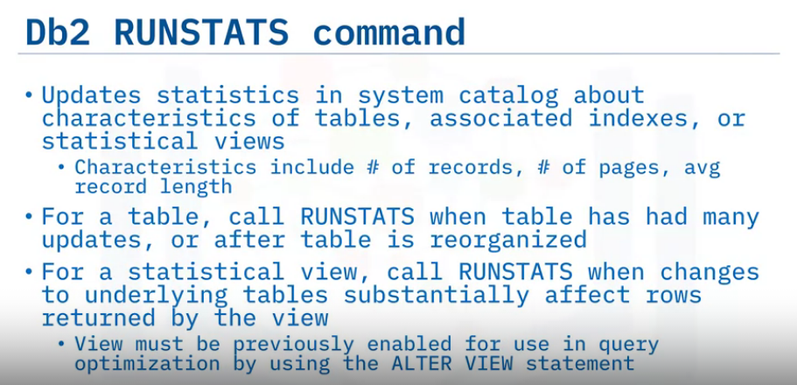
In Db2, the RUNSTATS command updates statistics in the system catalog about the characteristics of a table, associated indexes, or statistical views.
These characteristics include number of records, number of pages, and average record length.
The optimizer uses these statistics to determine access paths to the data.
For a table, call the RUNSTATS command when the table has had many updates, or after the table is reorganized.
For tables, this command collects statistics for a table on the database partition from which it is invoked.
If the table does not exist on that database partition, the first database partition in the database partition group is selected.
For a statistical view, call the RUNSTATS command when changes to underlying tables substantially affect the rows that are returned by the view.
The view must be previously enabled for use in query optimization by using the ALTER VIEW statement.
For views, this command collects statistics by using data from tables on all participating database partitions.

Slide 25
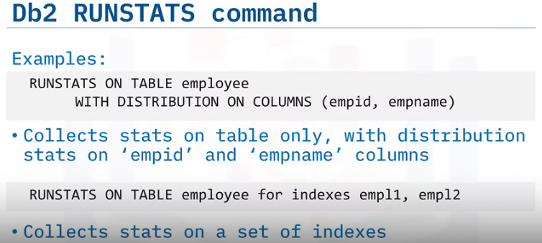
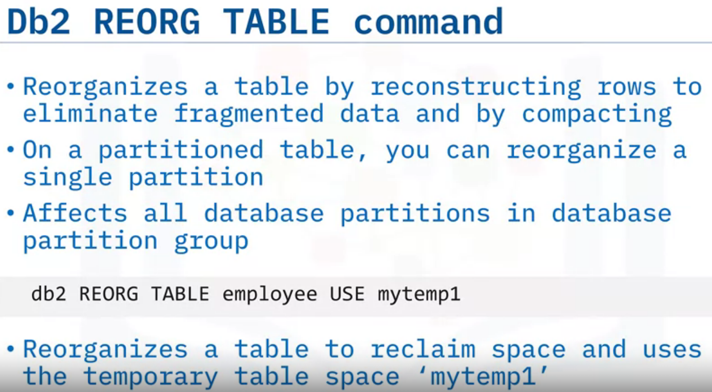
Here are some usage examples.
The first example collects statistics on the table only, with distribution statistics on the employee id and employee name columns.
And the second example collects statistics on a set of indexes.
In Db2,
the REORG TABLE command reorganizes a table by reconstructing the rows to eliminate fragmented data, and by compacting information.
On a partitioned table, you can reorganize a single partition.
In terms of its scope, the REORG TABLE command affects all database partitions in the database partition group.
Here is a simple usage example. This example will reorganize a table to reclaim space by using a temporary table space named mytemp1.

Slide 26
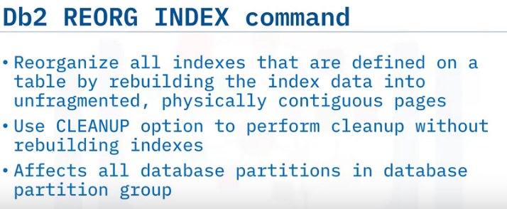
In Db2, the REORG INDEX command reorganizes indexes.
You can reorganize all indexes that are defined on a table by rebuilding the index data into unfragmented, physically contiguous pages.
On a data partitioned table, you can reorganize a specific nonpartitioned index on a partitioned table, or you can reorganize all the partitioned indexes on a specific data partition.
If you specify the CLEANUP option of the index clause, cleanup is performed without rebuilding the indexes.
You can clean up a specific index on a table, or you can clean up all of the indexes on the table.
In terms of its scope, the REORG INDEX command affects all database partitions in the database partition group

Slide 27
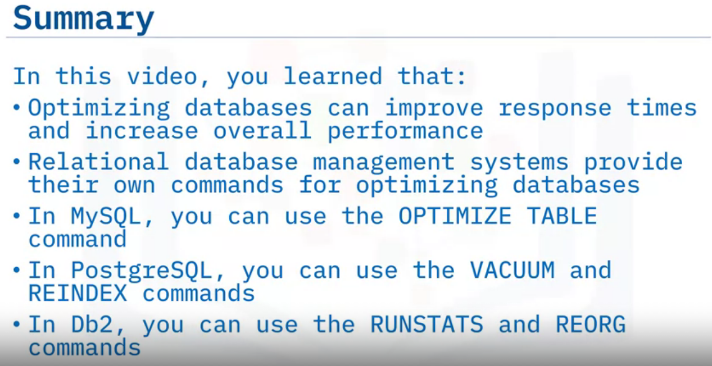

Slide 28
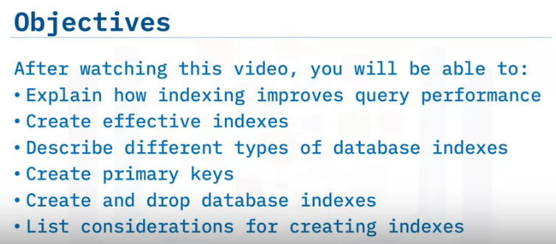
Using Indexes

Slide 29
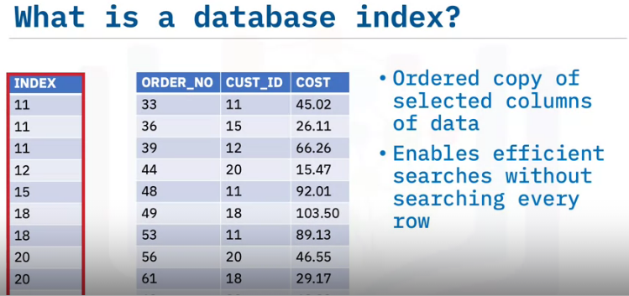
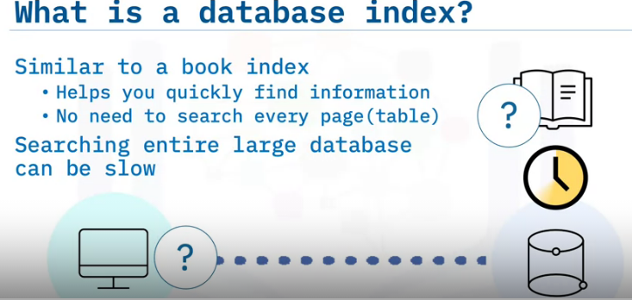
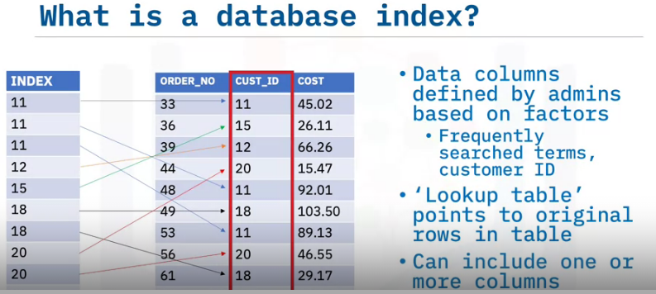
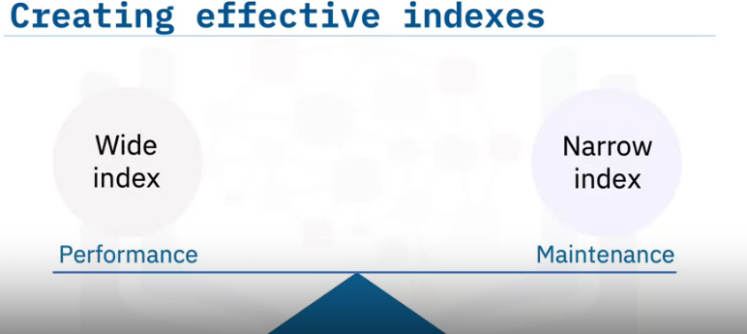

Slide 30
if you search a book without an index, you must search every page in the book to find the information you want.
Similarly, if a computer searches a database without an index, it must search the entire database to find the information, which can be very slow—particularly in a very large database.
A database index, however, can significantly improve search performance for a database.
In a database, the index is essentially an ordered copy of selected columns of table data and is designed to enable efficient searches without having to search every row in a database table every time it is accessed.
The columns selected to make an index are typically defined by administrators and can be based on many factors, such as frequently searched terms.
In this example, we are selecting the customer ID column. Regardless of how they are constructed, the overall goal of an index is to help users find the information they need quickly and easily.
So, an index serves as a ‘lookup table’ with a pointer or link to the original rows in the base table for which the index is created. An index can include one or more columns in the table.
However, while indexes can improve database performance, they also require additional storage space and maintenance because they must be continually updated.
For any database, you will likely have to experiment with different types of indexes and indexing options.
This will help you find an optimal balance of query performance and index maintenance—such as how much disk space and activity are required to keep the index up to date.
For example, narrow indexes, or indexes with relatively few columns in the index key, take up less disk space and require less overhead to maintain, whereas wide indexes, while they may cover a greater number of queries, also require more space and maintenance.

Slide 31
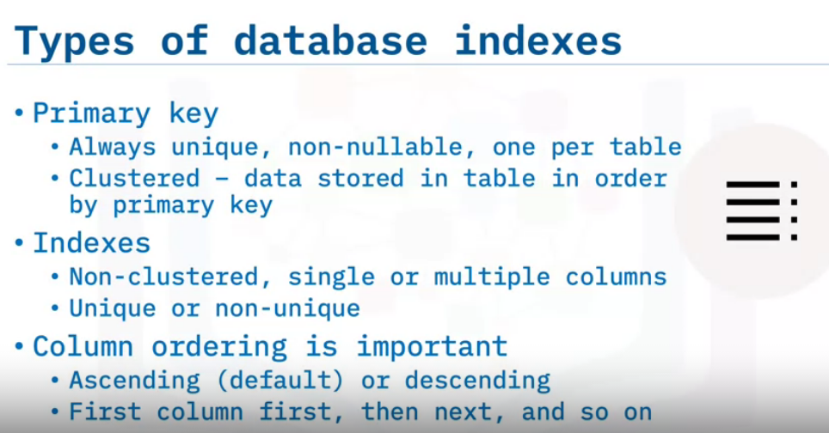
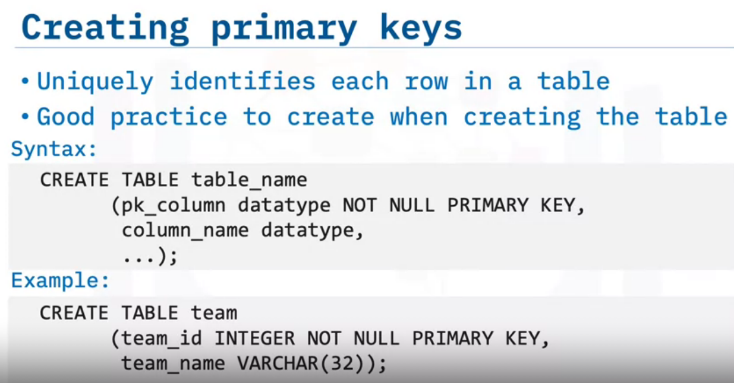
The primary key is a special type of index that is always unique, non-nullable, and there can only be one per table.
It is also clustered, meaning that the data is actually stored in the underlying table in the same order as the primary key.
Each table can also have any number of additional or secondary indexes other than the primary key.
These are non-clustered and can have single or multiple columns. Indexes can be defined as unique or non-unique.
Ordering of columns is important because an index will be sorted in the order in which columns are specified when the index is created.
Sorting can be ascending (which is the default) or descending, but it will sort by the first column first, then by the next column, and so on
The primary key of a table uniquely identifies each row in a table.
While having a primary key is optional in some RDBMSs, it is generally a good practice to create one when creating a table.
It may also be possible to add a primary key later by altering the table.
The first code block on this screen, shows the general syntax for creating a primary key when creating a table.
The second code block shows a simple example: This example would create a table called team with the team_id column as the primary key.

Slide 32
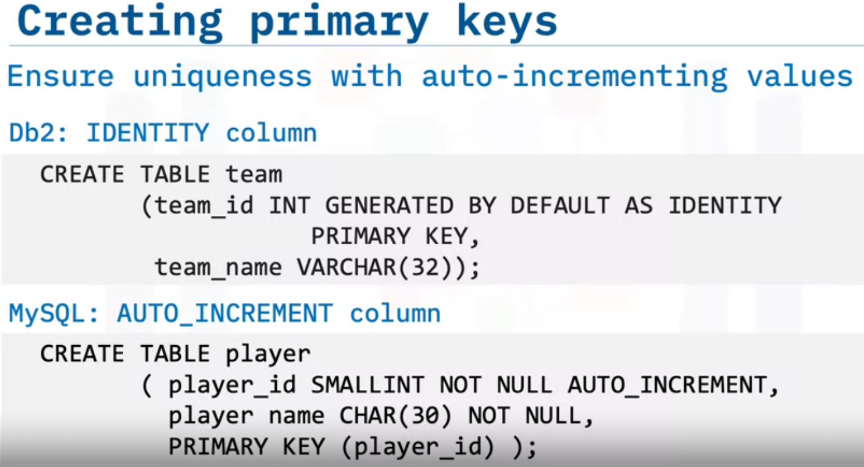
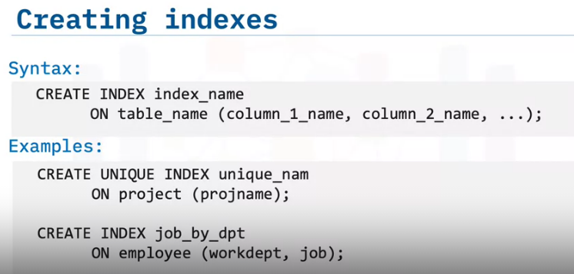
You use the CREATE INDEX statement to define an index, and you use the ON statement to specify on which database table to create it.
You specify the column names in parentheses, and the order in which you enter them dictates the index’s sort order.
And here are a couple of examples.
The first one creates a unique index named unique_nam in the project table, with a column named projname, meaning that the project table cannot have multiple rows with the same projname value.
When ON table_name is specified, the UNIQUE option prevents the table from containing two or more rows with the same value of the index key.
The second example creates an index named job_by_dpt in the employee table, and it includes workdept and job columns in that order.
This one is not unique, so the table can have multiple rows with the same workdept and job columns, but the benefit of the index is that query filtering on those fields will be faster than without an index.

Slide 33
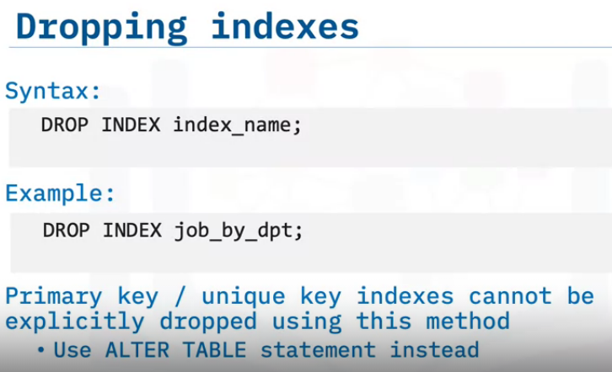
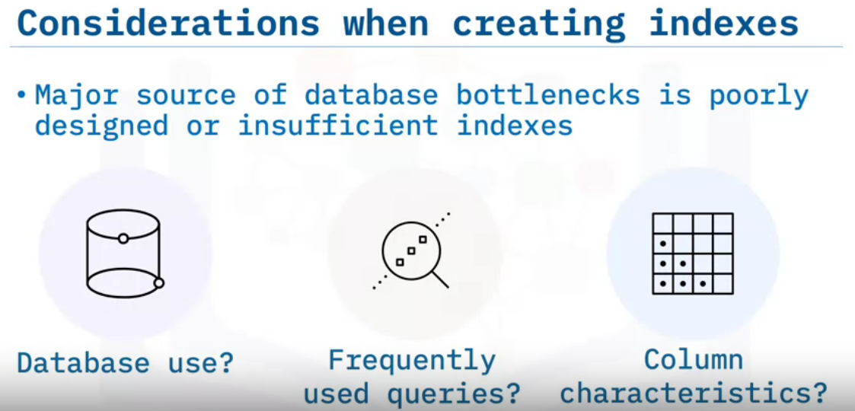
To delete an index, you use the DROP statement.
Dropping an index does not cause any other objects to be dropped but will cause packages that have a dependency on a dropped index or index specification to be invalidated.
This example deletes the index named job_by_dpt.
A primary key or unique key index cannot be explicitly dropped using the DROP statement.
Deleting the primary index or a unique key index is done through the ALTER TABLE statement.
After the primary key or unique key is deleted using ALTER TABLE, the index is no longer considered the primary index or unique index, and it can be explicitly dropped using the DROP statement.
One of the major sources of database application bottlenecks can be poorly designed indexes, or a lack of sufficient, appropriate indexes.
Therefore, designing efficient indexes is vital for optimizing database application performance.
When designing an index, you should consider the following core principles:
Understand how the database will be used.
For example, will it be used for heavy online transaction processing or for the storage and retrieval of large data sets?
Understand the most frequently used queries.
For example, if you know that a frequently used query joins two or more tables, that may assist you in deciding the most appropriate index type to use.
Understand the characteristics of the columns.
For example, what kind of data will they contain? Will they contain integer values? And will they be unique?
Knowing these characteristics from the outset will help you choose an appropriate index type.

Slide 34
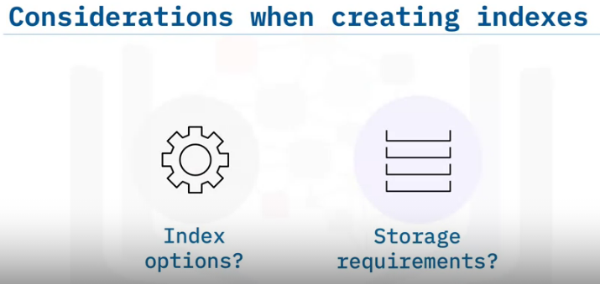

which indexing options will best improve its performance?
For example, if you are creating a clustered index on an existing large table, it would
be a good idea to use the ONLINE index option, as it permits concurrent activity
on the underlying data while the index is being built.
And where is the best place to store the index?
Where you decide to store your indexes can improve query performance by increasing the
performance of disk input/output operations.
For example, if you store a non-clustered index on a storage group located on a different
disk than where the table storage group is located, it can improve performance as both
disks could be read simultaneously.

